Slide 1

GranaSat Batteries Tester
Blanca Cano Camarero
Miguel Romero García

Slide 2
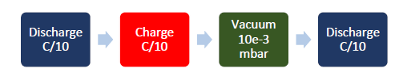
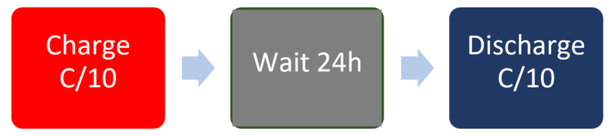
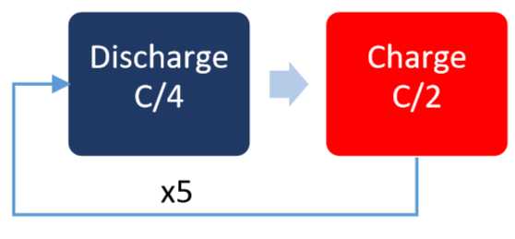
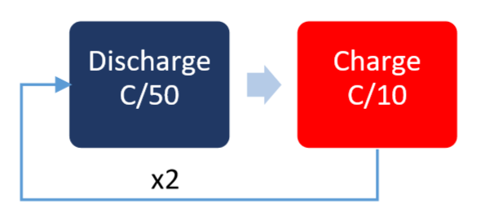
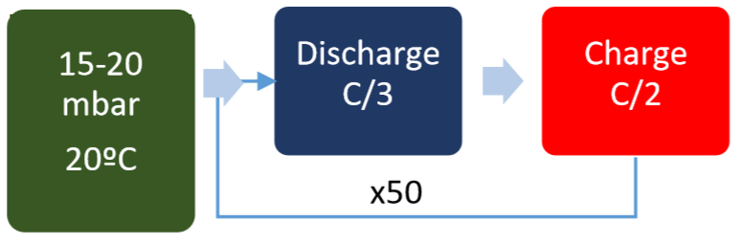
Test #1: High Vacuum Test
Test #2: Capacity and Internal Resistance vs Temperature
C → Measure of the rate at which a battery is discharged relative to its maximum capaity
Battery capacity versus temperature
Battery internal resistance versus temperature
Charging/ discharging voltage and current curves at different temperatures.
Battery size in charged and uncharged state
Battery capacity
Battery loss percentage after vacuum
Change in size after vacuum test
Test #3: Self-Discharge Test
Test #4: LEO Cycling
Battery degradation over continuous charge/discharge periods at border temperatures.
Battery charge/ discharge curve degradation.
Battery loss of energy over long periods.
Test #5: EMF vs SOC
Test #6-7: Reduced pressure 30 %/80% DOD Cycling
Battery curve of the electromotive force versus the state of charge
Evolution of EODV (End of Discharge Voltage) versus degradation.
Evolution of the battery capacity and efficiency versus degradation

Slide 3
